Slide 1
Photomicrographs of Plant foods
Eggplant
Permission to reproduce original photomicrographs used to make this collection may be obtained from
Dr. David O. Norris at
david.norris@colorado.edu

Slide 2
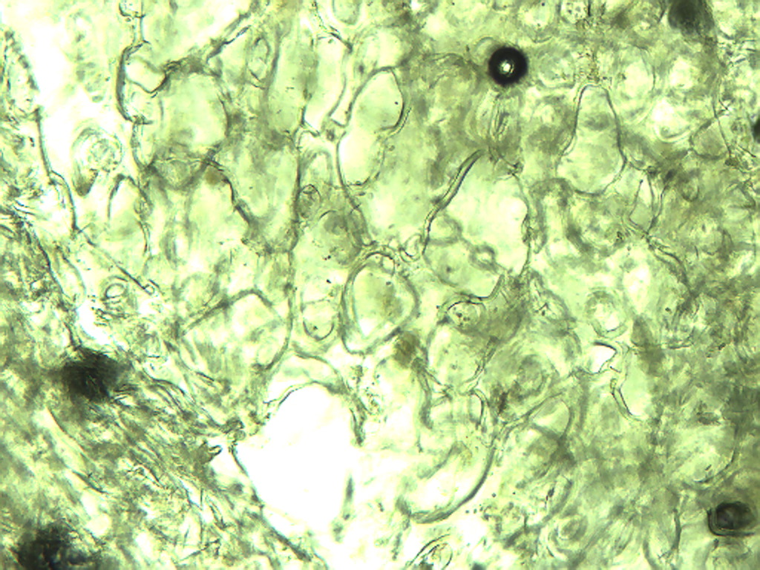
Notes:
170. Solanum melongena L. Eggplant. Skin, 10X. Air bubbles (arrows).

Slide 3
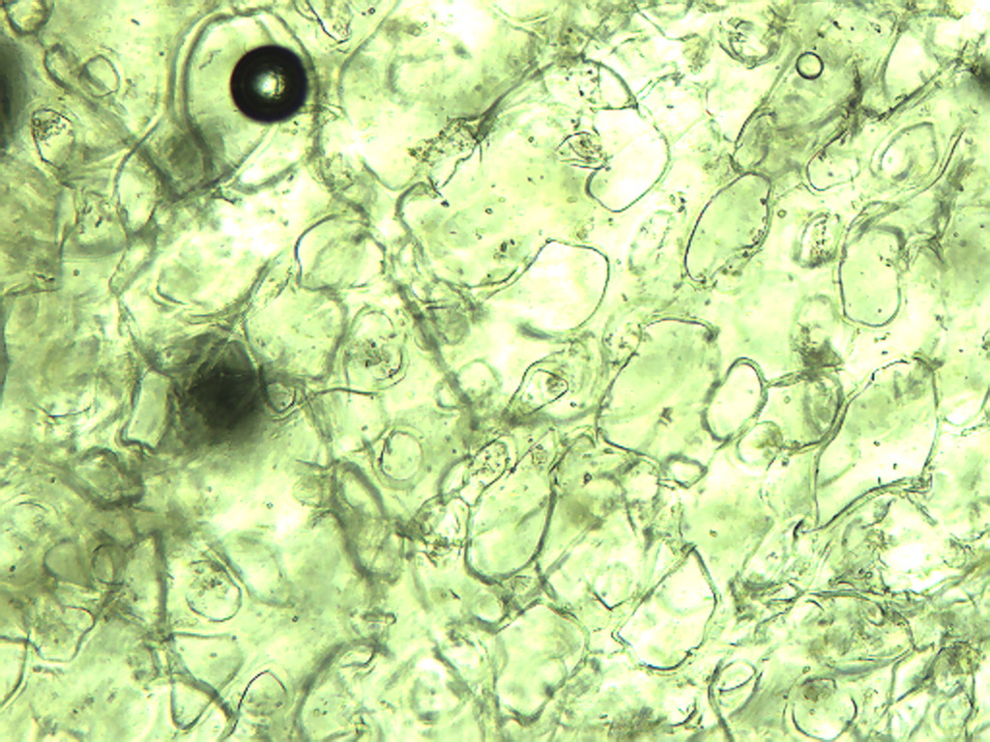
Notes:
171. Eggplant. Skin, 10X.

Slide 4
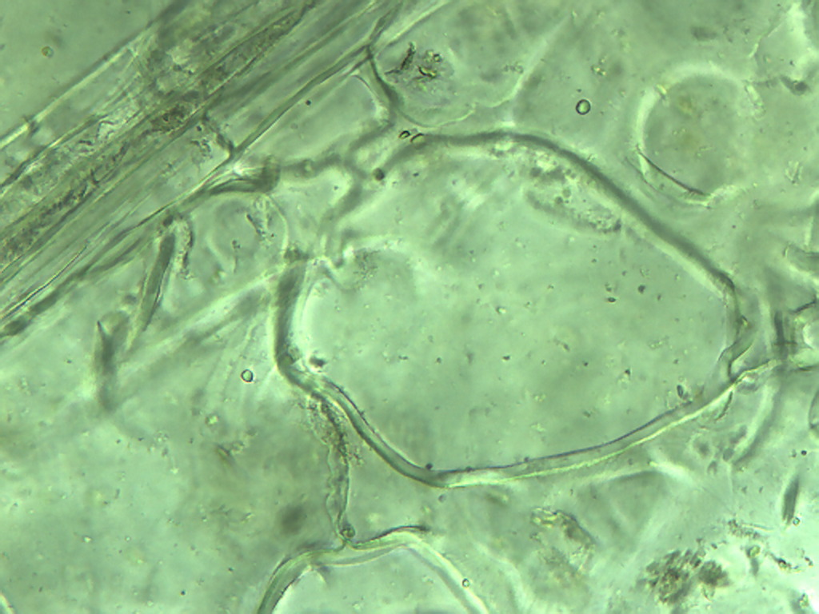
Notes:
172. Eggplant. Skin, 25X.

Slide 5
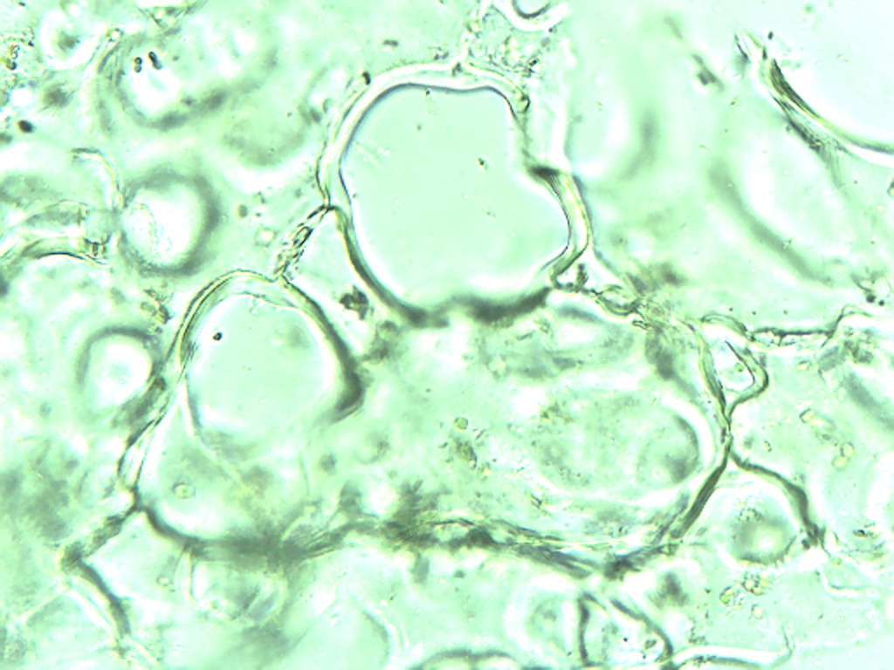
Notes:
173. Eggplant. Skin, 25X.

Slide 6
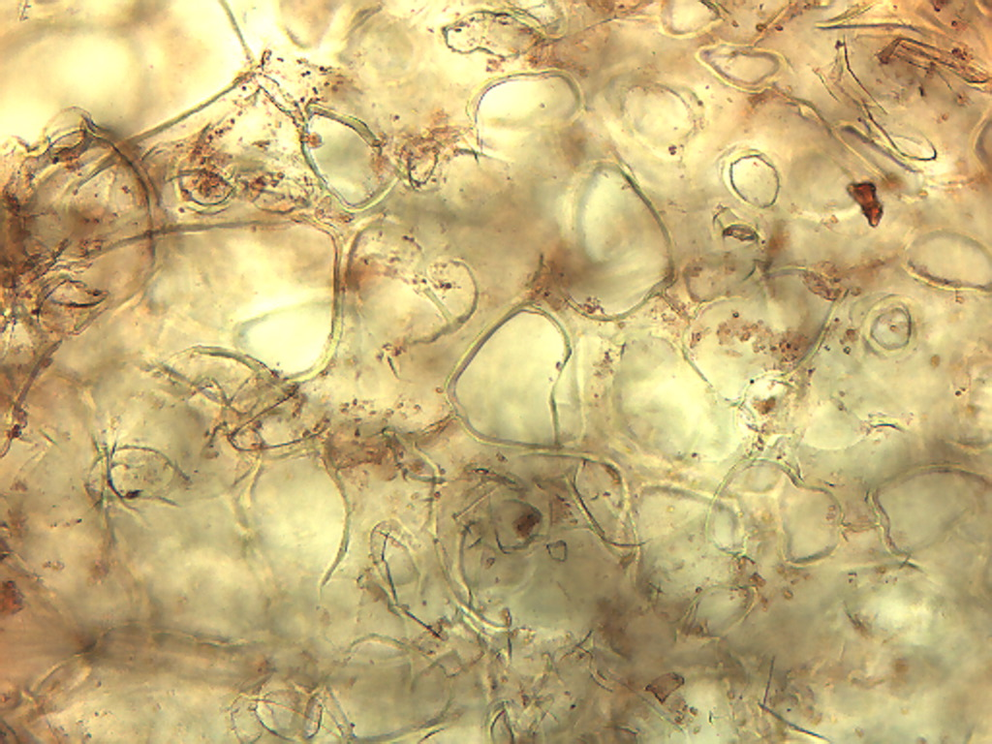
Notes:
174. Eggplant. Skin cells stained with safranin, 10X.

Slide 7
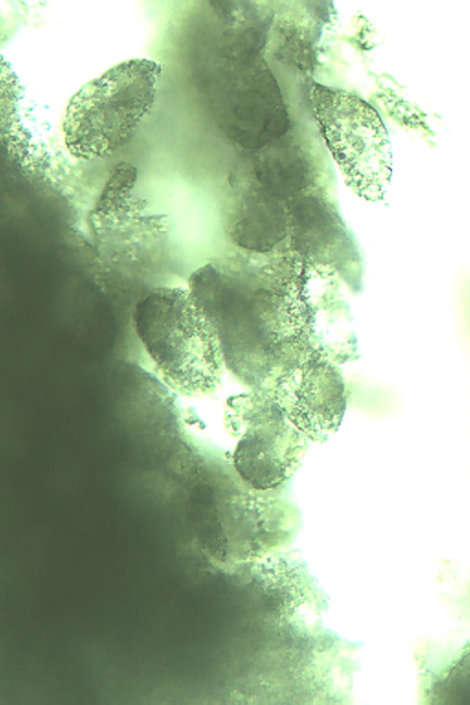
4X
25X
Notes:
175. Eggplant. Dark pulp. Arrow indicates region (4X) enlarged at right (25X).

Slide 8
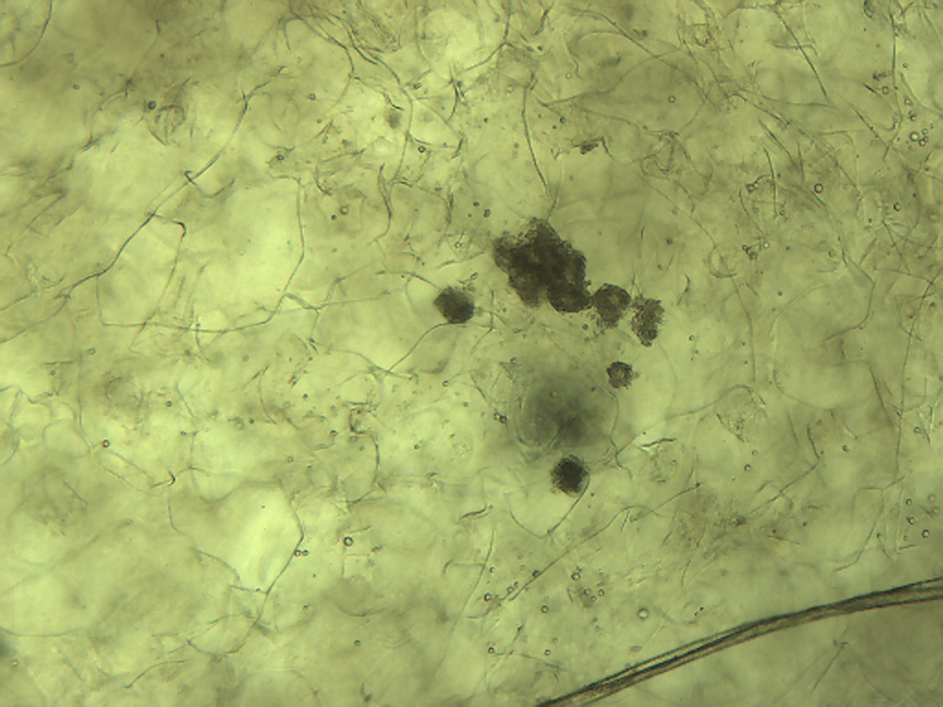
Notes:
176. Eggplant. Pulp: large and small parenchymal cells, 10X.

Slide 9
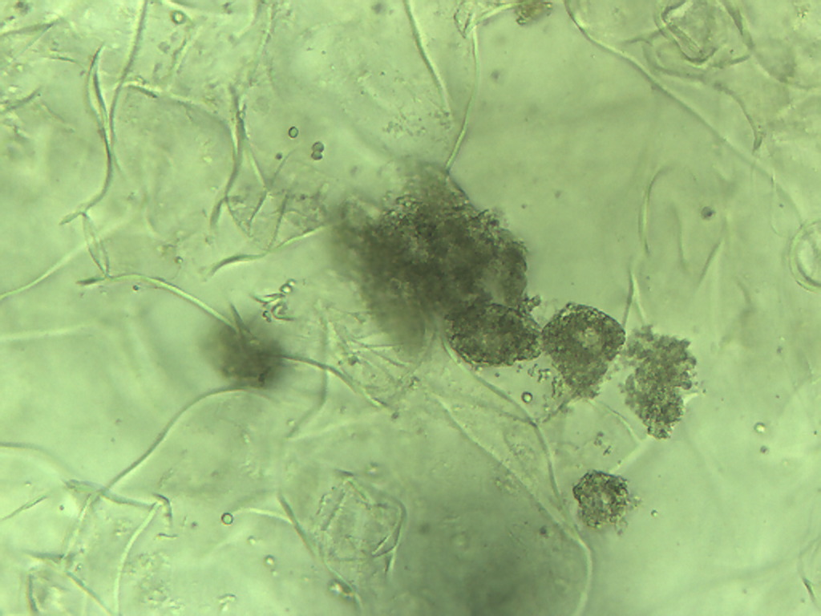
Notes:
177. Eggplant. Pulp cells: large and small, 25X.

Slide 10
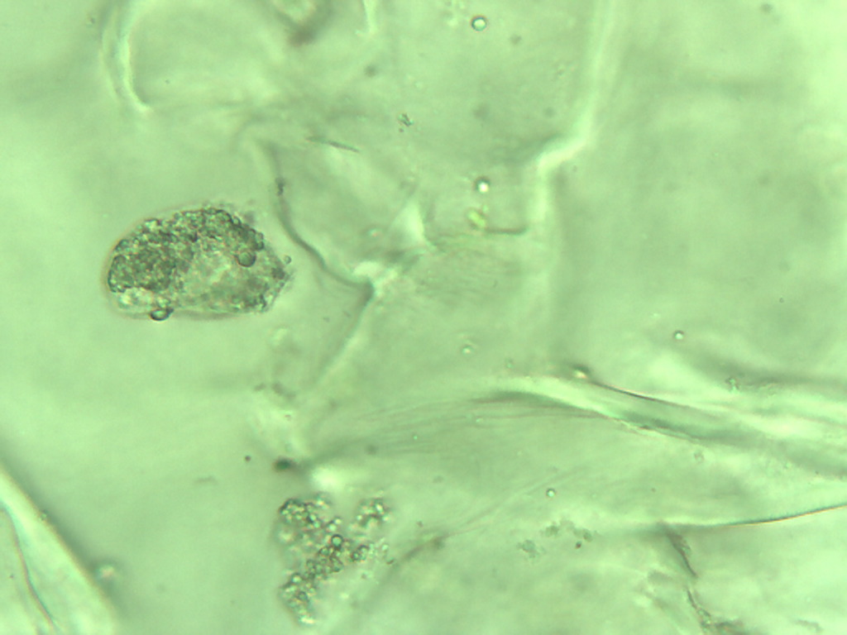
Notes:
178. Eggplant. Pulp cells, 40X.

Slide 11
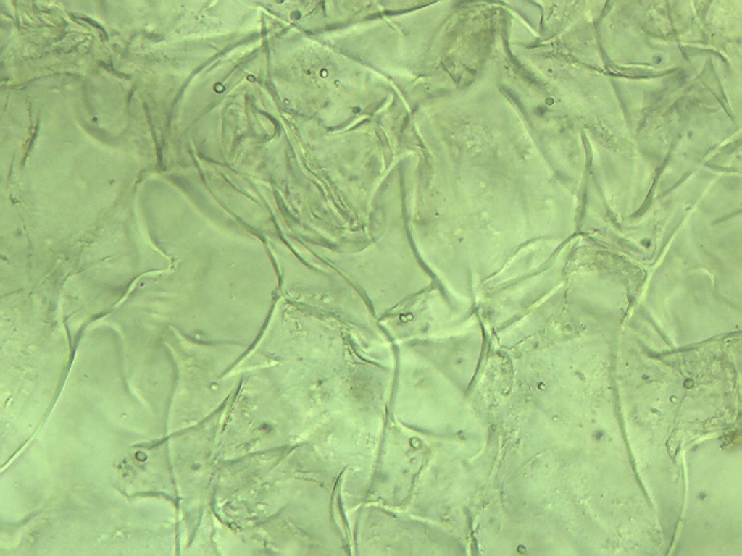
Notes:
179. Eggplant. Large pulp parenchymal cells, 25X.

Slide 12
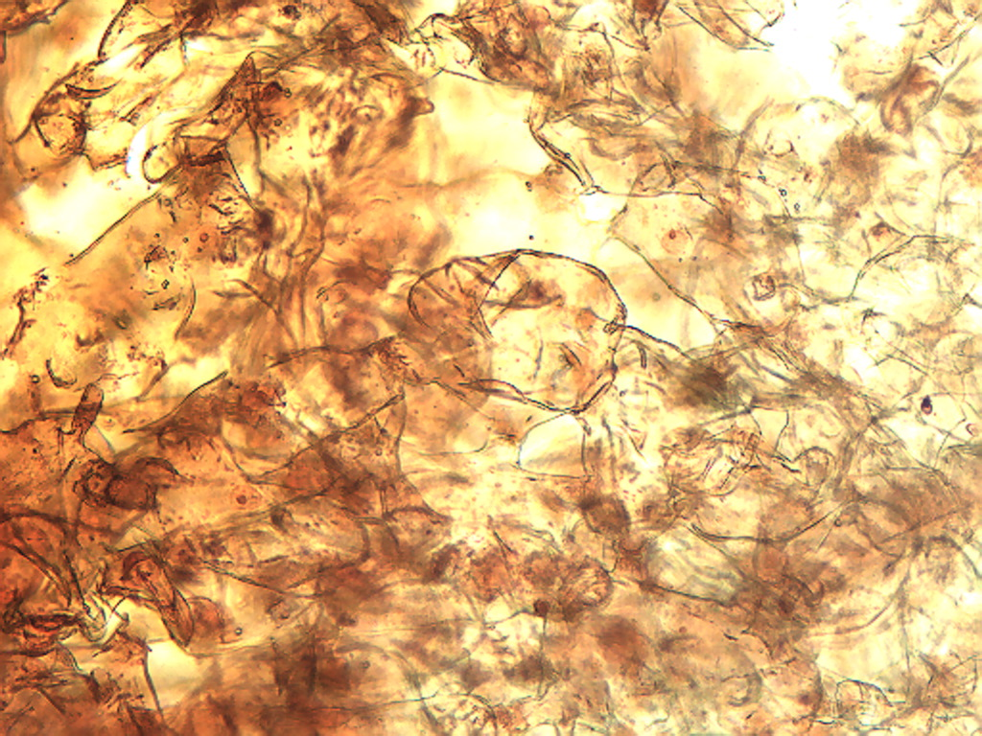
Notes:
180. Eggplant. Pulp cells stained with safranin, 10X.

Slide 13
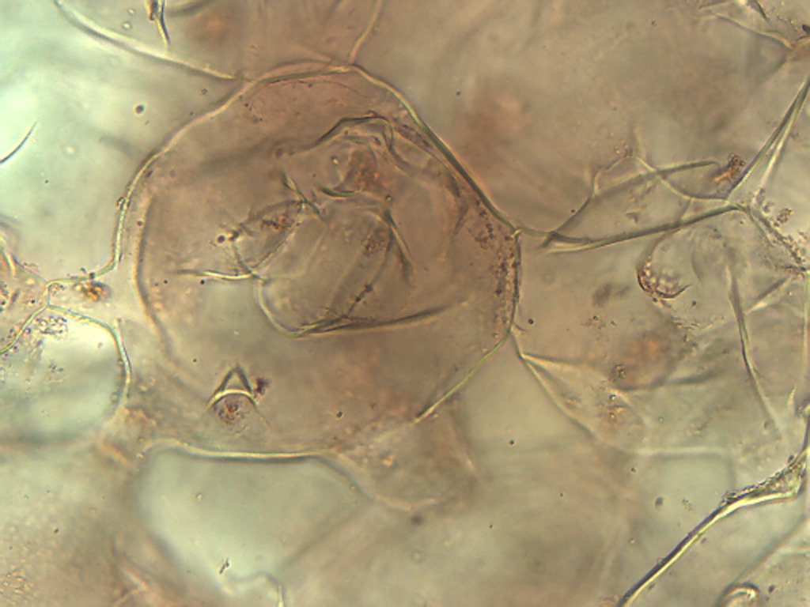
Notes:
181. Eggplant. Large pulp cells stained with safranin, 25X.

Slide 14
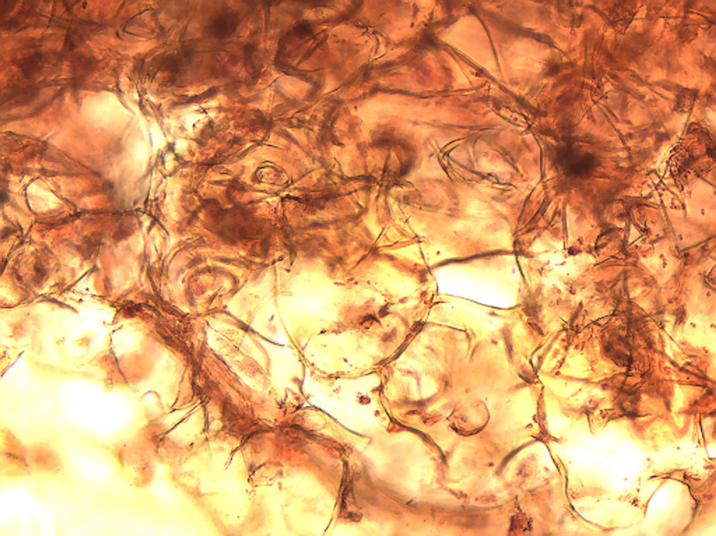
Notes:
182. Eggplant. Pulp cells stained with safranin, 10X.

Slide 15
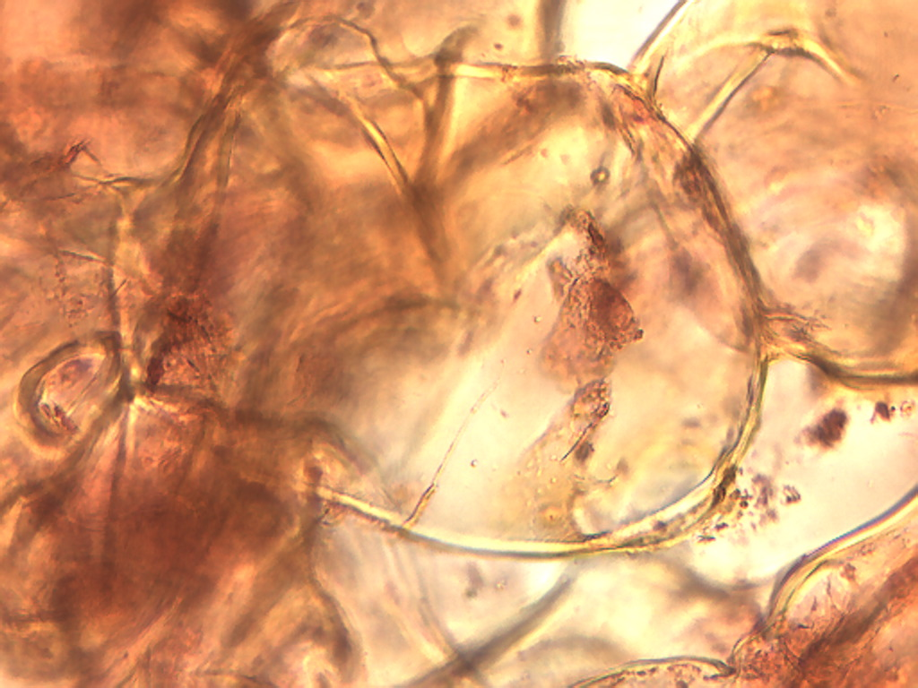
Notes:
183. Eggplant. Large pulp cells stained with safranin, 25X.

Slide 16
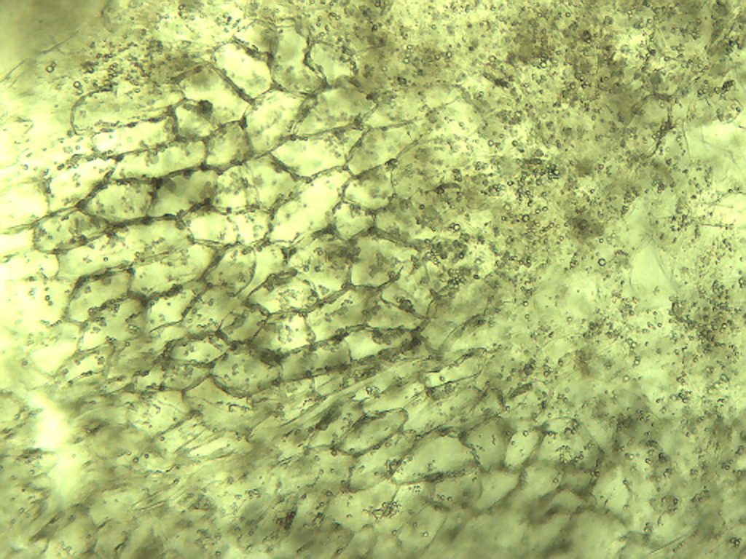
Notes:
184. Eggplant. Pulp epidermal-like cells, 10X.

Slide 17
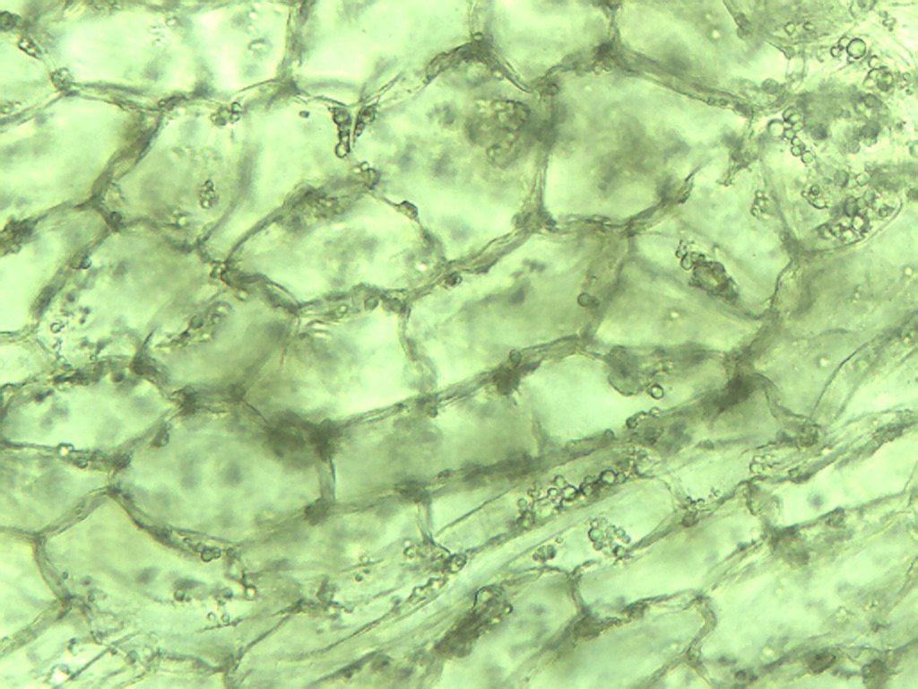
Notes:
185. Eggplant. Epidermal-like cells in pulp, 25X.

Slide 18
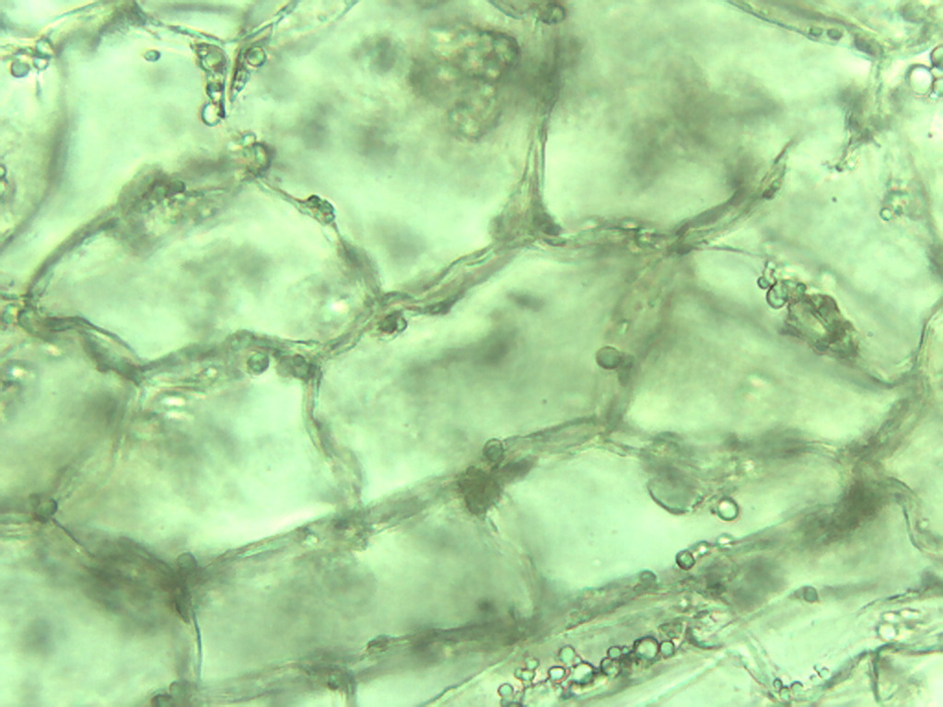
Notes:
186. Eggplant. Epidermal-like cells in pulp, 40X.

Slide 19
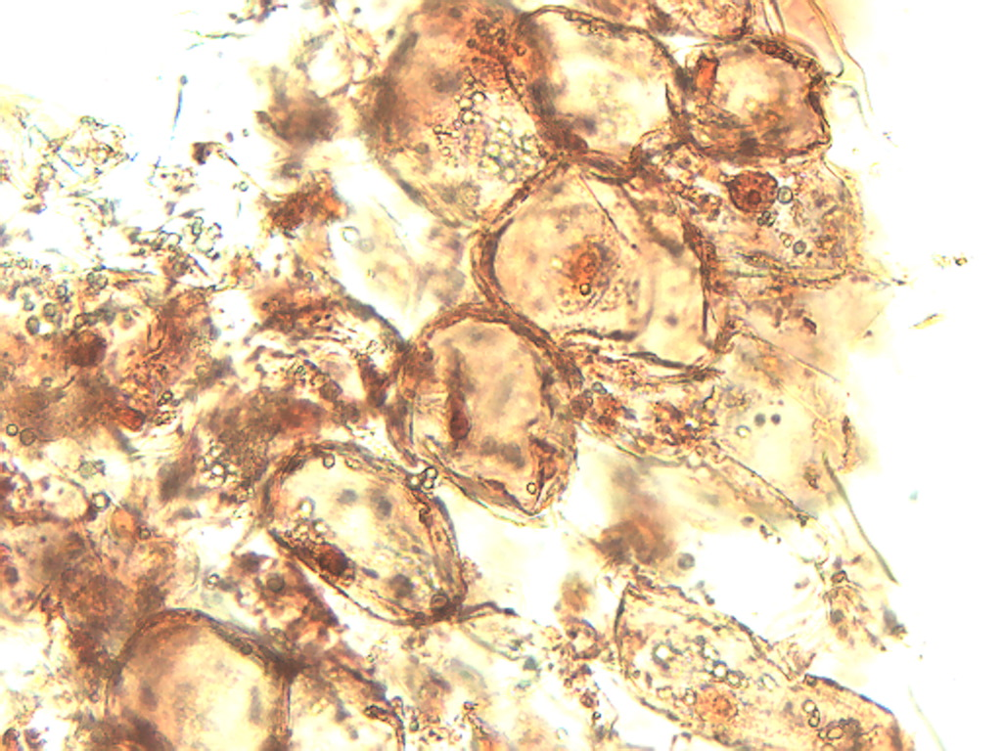
Notes:
187. Eggplant. Pulp cells stained with safranin, 25X.

Slide 20
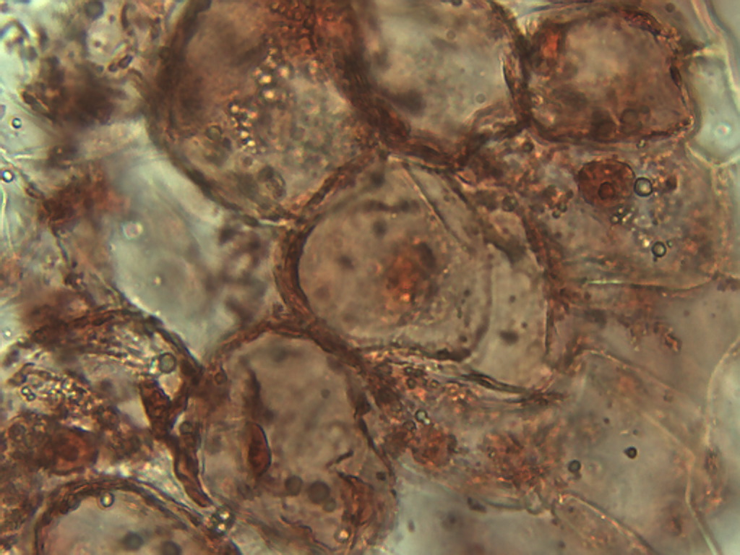
Notes:
188. Eggplant. Pulp cells stained with safranin, 40X.

